Slide 1


Face Mask Detection
MINI PROJECT PHASE-1
Presented by:
Akash S S (1DS18IS008)
Kedar Hegde (1DS18IS035)
Rahul B V (1DS18IS045)
Sandesh S Hegde (1DS18IS057)
Under The Guidance Of
LATHA A P
Assistant Professor
Dept. of Information Science
and Engineering
DSCE, Bangalore

Slide 2

Face Mask Detection

Slide 3
Abstract
The new Coronavirus disease (COVID-19) has seriously affected the world. To limit the spread of the disease, mandatory face-mask rules are now becoming common in public settings around the world. Additionally, many public service providers require customers to wear face masks under predefined rules (e.g., covering both mouth and nose) when using public services. These developments inspired research into automatic (computer-vision-based) techniques for face-mask detection to help monitor public behavior and contribute to constraining the COVID-19 pandemic.

Slide 4
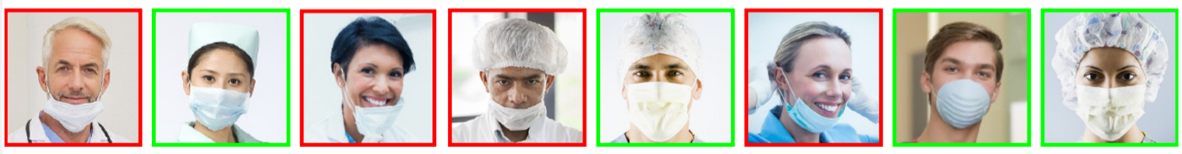
Introduction
Face-mask detection represents both detections as well as a classification problem because it requires first the location of the faces of people in digital images and then the decision of whether they are wearing a mask or not.
Example images from the MAFA dataset.

Slide 5

Literature Survey (mentioned only 2 here)
REAL-TIME FACE MASK DETECTION AND TRACKING USING OPENCV, International Journal of Soft Computing and Artificial Intelligence, ISSN: 2321-404X, Volume-2, Issue-1, May- 2014
“ MAMATA S. KALAS ”
Face Recognition: A Literature Survey by
“ W. ZHAO - Sarnoff Corporation, R. CHELLAPPA - University of Maryland, P. J. PHILLIPS - National Institute of Standards and Technology and A. ROSENFELD - University of Maryland ”

Slide 6
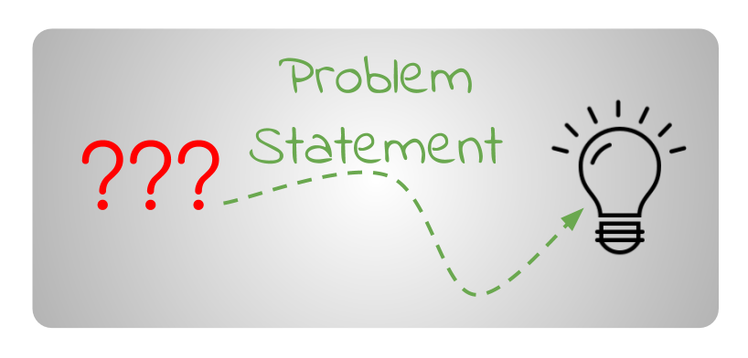
Problem Statement
Detect people that pass through a security-like camera and identify their face mask usage.

Slide 7
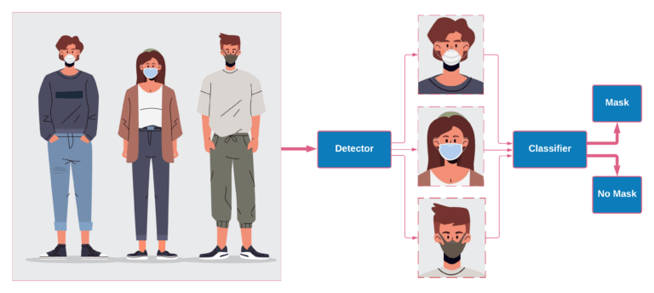
Motivation of the Project
We were curious about building a face mask detector that can generalize well to real-world data. We tried different datasets with several detectors and classifiers to come up with the right solution. No mask dataset and build a face mask classifier that can also work well on real-world data.

Slide 8
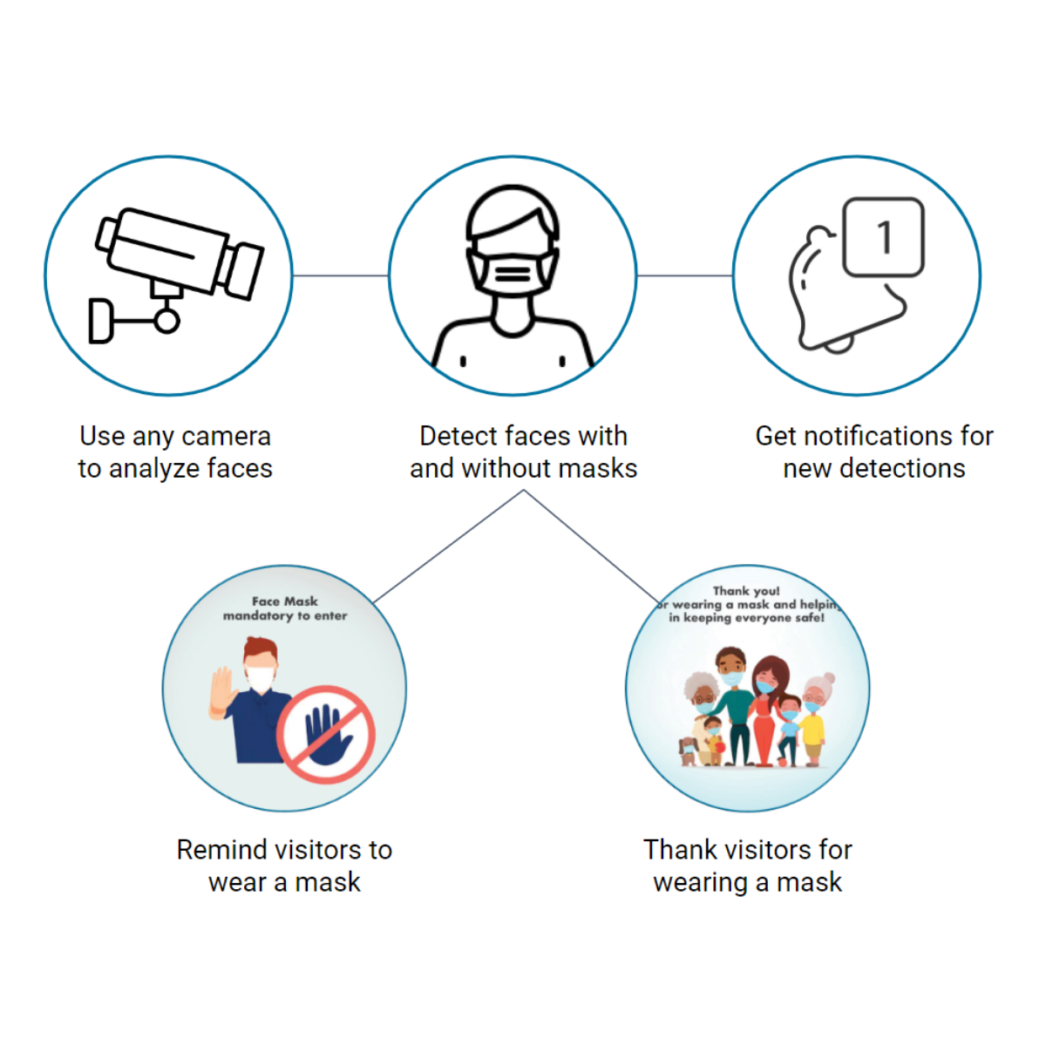
Objective & Scope of the Project
Check Individuals And Crowds Wearing Masks In Public.
Use Digital Screens To Remind Visitors To Wear Masks.
Alert Staff When No Masks Are Detected - Distress Signal deployment.
Works With Existing USB Or IP Cameras With RTSP Streams.
Anonymous & Spoof Proof.

Slide 9

Methodology
The classification of the images is done by training the model in 2 phases:
Phase 1: The face mask dataset is loaded into the system. A classifier like Haar Cascade is used to generate a trained model.
Phase 2: Load the face mask classifier model.
Detect faces in the images/video stream. Apply the classifier to each face. Classify the images to be With Mask and Without Mask.

Slide 10

Hardware & Software Requirements
HARDWARE REQUIREMENTS
Desktop or Laptop with Windows/Linux/macOS having specs:
4 GB RAM (or higher).
Minimum of 2 GB of memory (HDD or SSD).
High-speed Internet Connection.
Integrated or a separate Webcam.
Graphics Card 512 MB (or higher).
Facemasks for testing.
SOFTWARE REQUIREMENTS
Python IDE (Spyder or PyCharm).
pip installer to install modules.
Modules like TensorFlow, Keras, NumPy, CV2, etc.
Haar Cascade Classifier

Slide 11

Contribution of the Project
Since the COVID-19 pandemic has created a lot of chaos, wearing masks and preventing the spread of the virus should be one’s top priority. In social gatherings, people usually tend to loosen their masks for their comfort. This increases the spread of the virus.
It requires a lot of manpower to control the crowd and check if they’re wearing masks properly or not. Instead, we can use this project in order to alert the staff so that they can make people wear masks properly or keep a penalty so that people wear them properly. This reduces the spread of the virus which in turn brings an end to this pandemic.

Slide 12

References
World Health Organization. Coronavirus Disease (COVID-19): Advice for the public.
Centers for Disease Control and Prevention. Considerations for Wearing Masks.
TensorFlow Documentation.

